Slide 1


Google
Play Store
Analysis
Market
Analysis
End-to-End Data Analytics Project transforming marketplace data into actionable business intelligence.
PREPARED BY
Parth Soni
2026
TECHNOLOGIES
Edition
Python
PostgreSQL
SQL
Power BI
Git
GItHub

Slide 2
02
Executive Summary
GOOGLE PLAY STORE MARKET ANALYSIS — PROJECT OVERVIEW
01
02
03
04
BUSINESS PROBLEM
ANALYTICS WORKFLOW
OBJECTIVE
OUTCOME
Increasing competition & revenue optimization challenges in the app marketplace
Transform raw marketplace data into actionable business insights
Data cleaning → SQL analysis → Power BI dashboard development
Data-driven business intelligence enabling strategic decisions

Slide 3


03
Business Problem & Objectives
CHALLENGES FACING THE MARKETPLACE & GOALS DRIVING THIS ANALYSIS
Increasing competition in the Google Play Store making it harder to identify profitable opportunities.
Difficulty identifying high-revenue categories and understanding customer engagement patterns.
Objectives: Clean data, analyze marketplace trends, and build comprehensive SQL reports.
Develop an interactive Power BI dashboard to generate actionable business insights.

Slide 4
04
Project Workflow
END-TO-END DATA ANALYTICS PIPELINE FROM RAW DATA TO BUSINESS INSIGHTS
02
04
DATA
PREPARATION
SQL ANALYSIS
Raw dataset ingestion, handling missing values, removing duplicates, and standardizing formats.
Loading data into PostgreSQL and executing SQL queries for category and revenue analysis.
POWER BI
DASHBOARD
FEATURE ENGINEERING
01
03
Building interactive dashboards to visualize KPIs and deliver actionable business insights.
Creating meaningful variables using Python, Pandas, and NumPy for deeper analysis.

Slide 5
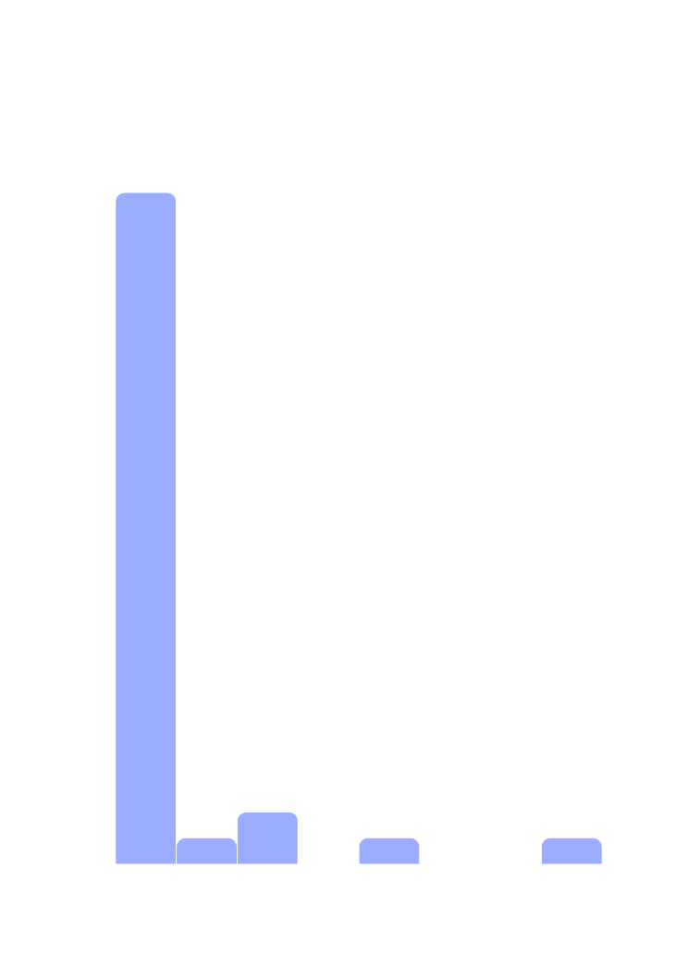

05
Data Preparation
EXPLORATORY ANALYSIS OF CLEANED AND ENGINEERED MARKET PLACE DATA
Data Cleaning: Removed duplicate entries and handled missing values across app name, category, rating, size, installs, and price fields to ensure dataset integrity.
Feature Engineering: Created meaningful derived variables including install tiers, revenue estimates, and engagement ratios to enable deeper analytical segmentation.
Exploratory Data Analysis: Generated summary statistics and distribution analysis across categories, revealing skewed install distributions and concentration in dominant app categories.
Key Finding: A small subset of categories accounts for the majority of app counts and installs, while a long tail of niche categories holds minimal market presence.
10K+
APPS CLEANED & ANALYZED

Slide 6

SQL
Analysis
TOP RATED APPS
SQL queries identified top-rated applications by filtering apps with a minimum review threshold. Results revealed that high ratings alone do not guarantee high install counts, highlighting the importance of combining quality signals with marketing reach and category positioning for sustained growth.
+6
01
BUSINESS
INSIGHT AREAS
REVENUE BY CATEGORY
Revenue analysis by category exposed significant concentration in a small number of high-value segments. Games, Productivity, and Business categories account for the majority of estimated revenue, while many niche categories show minimal monetization potential despite maintaining a steady presence in the marketplace.
02
CATEGORY PERFORMANCE
Ranked categories by installs and revenue to identify top-performing segments.
CUSTOMER ENGAGEMENT METRICS
INSTALL BASE ANALYSIS
Review and rating analysis confirmed a strong positive correlation between install volume and review count. Apps with higher installs consistently attract more reviews, reinforcing social proof dynamics. Average rating across the catalog stands at 4.07, indicating generally positive user sentiment but limited differentiation at the top tier.
Segmented apps by install tiers to reveal distribution patterns across the catalog.
03
FREE VS PAID APPS
Compared monetization models across categories to evaluate revenue trade-offs.

Slide 7
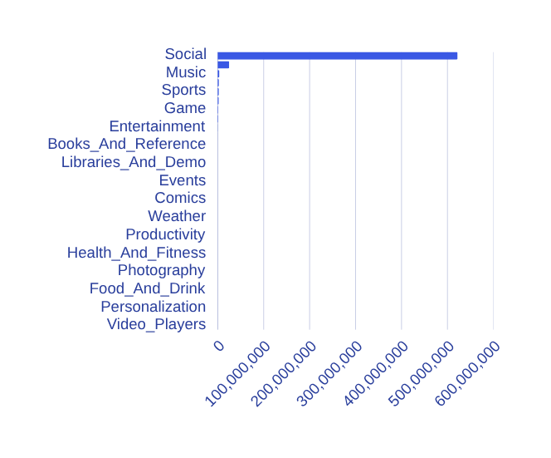
07
Interactive
Power BI
Dashboard
DASHBOARD OVERVIEW: KPIS, VISUALS & INTERACTIVE FILTERS
4.07
The Power BI dashboard transforms raw marketplace data into dynamic, interactive business intelligence. KPI Cards display total revenue estimates, aggregate installs, and average ratings at a glance. Category Performance Visuals highlight which segments dominate the Play Store. Install Trend charts reveal growth patterns across app tiers. Interactive Filters enable stakeholders to slice data by category, pricing model, and rating band — empowering data-driven strategic decisions in real time.
Avg. app rating
across marketplace

Slide 8

08
Key Insights
95.9%
CRITICAL DATA-DRIVEN FINDINGS FROM THE GOOGLE PLAY STORE ANALYSIS
FREE APPS DOMINATE CATALOG
Analysis of the Google Play Store reveals clear patterns in app distribution, monetization, and user engagement. Free applications overwhelmingly dominate the marketplace, while a small number of categories capture the majority of installs and estimated revenue.
Games & Productivity lead in installs and app counts
Customer reviews strongly correlate with higher downloads
Average app rating is 4.07 — but rating alone doesn't drive success
Revenue is concentrated in a few high-performing categories
Install distribution shows a sharp drop from low to very high tiers

Slide 9
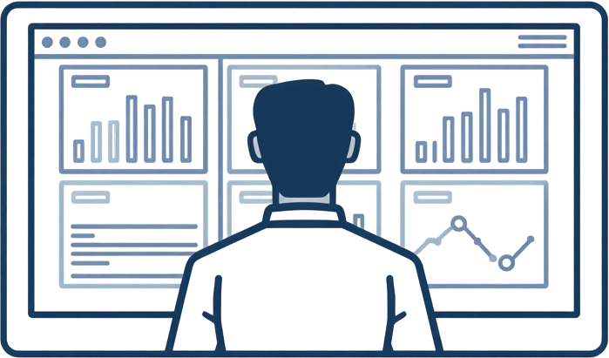
Key
Insights
(Cont'd)
Google
Play Store
Monetization mix, install distribution patterns, and the relationship between reviews, installs, and ratings.
MONETIZATION MIX
Varies widely by category
Page
INSTALL TIERS
9 of 11
Sharp drop: low to high

Slide 10




01
02
03
04
IMMEDIATE
ACTIONS
STRATEGIC
ACTIONS
FUTURE
SCOPE
ROADMAP
OVERVIEW
Improve application quality and ratings. Increase customer reviews and engagement. Optimize Play Store listings for discoverability and conversion.
Focus investments on high-growth categories. Adopt Freemium pricing models to balance revenue and installs. Enhance user retention programs.
Implement Machine Learning for predictive analytics. Develop Recommendation Systems for personalized user experience. Build Real-Time Dashboards.
A phased approach from quick wins to long-term innovation ensures sustainable growth, improved monetization, and data-driven competitive advantage.
Business
Recommendations
A structured roadmap translating key insights into actionable strategies — from immediate operational improvements to strategic investments and future-ready innovations powered by machine learning and real-time analytics.

Slide 11




Thank You!
Questions &
Next Steps?
parth.soni@email.com
github.com/parthsoni
linkedin.com/in/parthsoni

